Slide 1
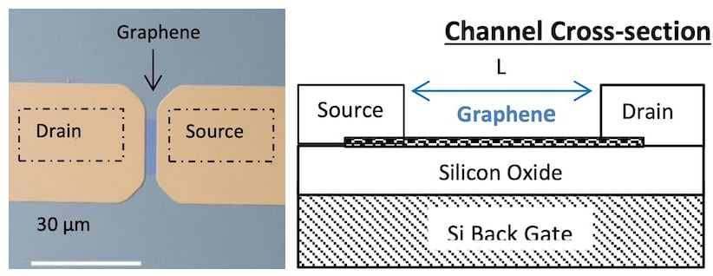
Graphene Field Effect Transistors
STRUCTURE OF A GFET:
A graphene field-effect transistor (GFET) consists of a graphene channel that acts as the conductive path between two electrodes, called the source and drain. Positioned on either side of the graphene channel, these electrodes allow current to enter from the source and exit through the drain
INTRODUCTION :
Graphene field-effect transistors (GFETs) take the typical FET device and insert a graphene channel tens of microns in size between the source and drain.
Being graphene, a lattice of carbon atoms that is only one atom thick, the channels in GFETs have unprecedented sensitivity.

Slide 2
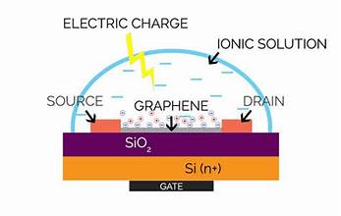
BENEFITS OF GFET’S : Unprecedented Sensitivity:
With a GFET, the graphene channel is only one atom thick, meaning the entire channel is effectively on the surface and directly exposed to the environment. Fewer Molecular Defects: Graphene can be produced in a single layer with a high degree of accuracy and precision. Furthermore, a two-dimensional material such as graphene, produced efficiently, will have much less dangling surface bonds.
Superior Conductivity:
GFETs also have a higher carrier mobility than traditional FETs
LIMITATIONS OF GFET’S:
Mass producing graphene has defects and impurities
Scalability
Debye-Hückel screening phenomenon
APPLICATIONS:
Chemical vapor sensing, or “nose like” vapor sensing, is another application that uses GFETs. To do this, GFETs were functionalized with single-stranded DNA to detect various chemical vapors.
Other applications include biological sensors, healthcare equipment, chemical sensors
ASIMA SHAIK RA2311004010388
ADITYA KOMATH RA2311004010370

